Slide 1
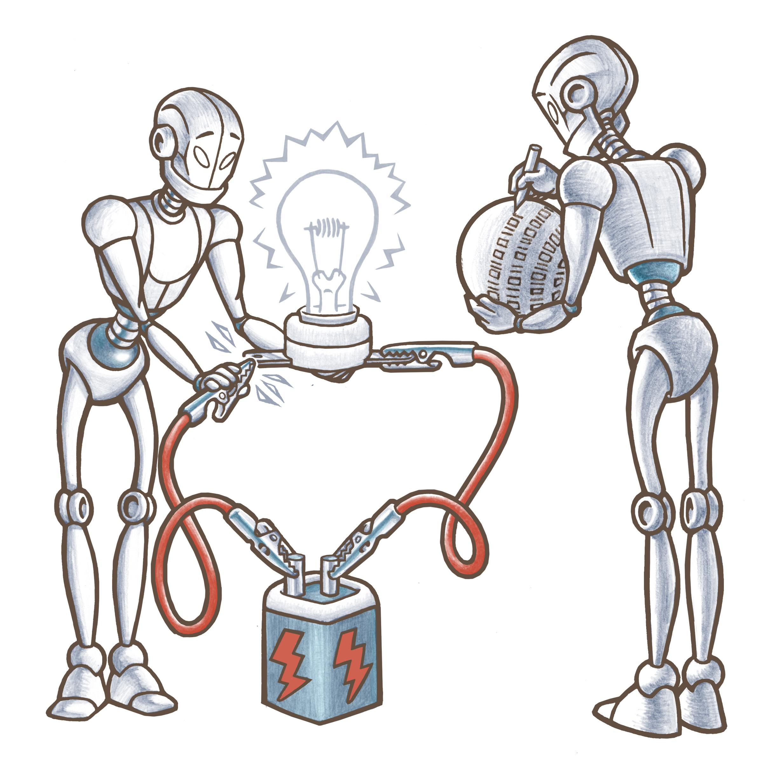
MetaAutomation
Matt Griscom
October 8th, 2018
Notes:
50 minutes total. This slide done at 0:00 to start 50 minutes

Slide 2
MetaAutomation is …
Not a tool
Not a fad
A big investment
A huge return
Notes:
End at 4:30

Slide 3
Team on track
?
QA on it
Visible quality
Focused notifications
Notes:
End at 5:00

Slide 4
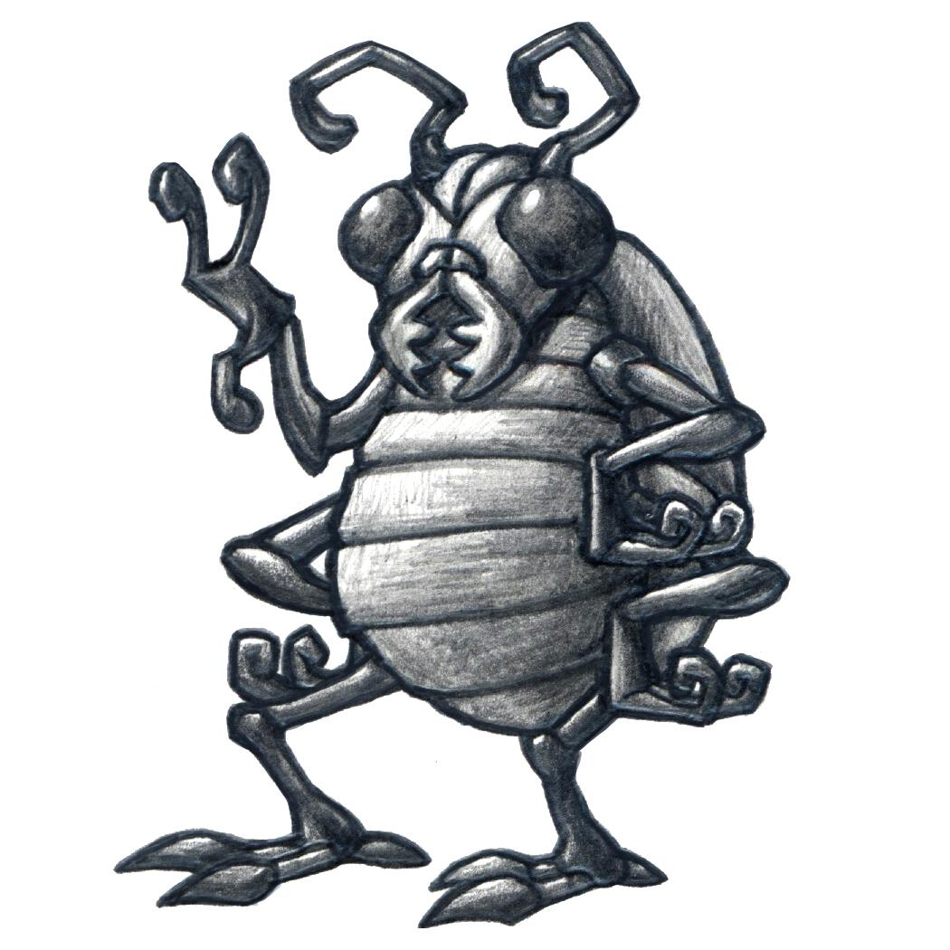
“Test Automation” is broken
Linguistic Relativity
“Testing is the process of executing a program with the intent of finding errors.“ - Glenford Myers, 1979
Must verify Requirements, too…
Notes:
End this slide at 6:00

Slide 5
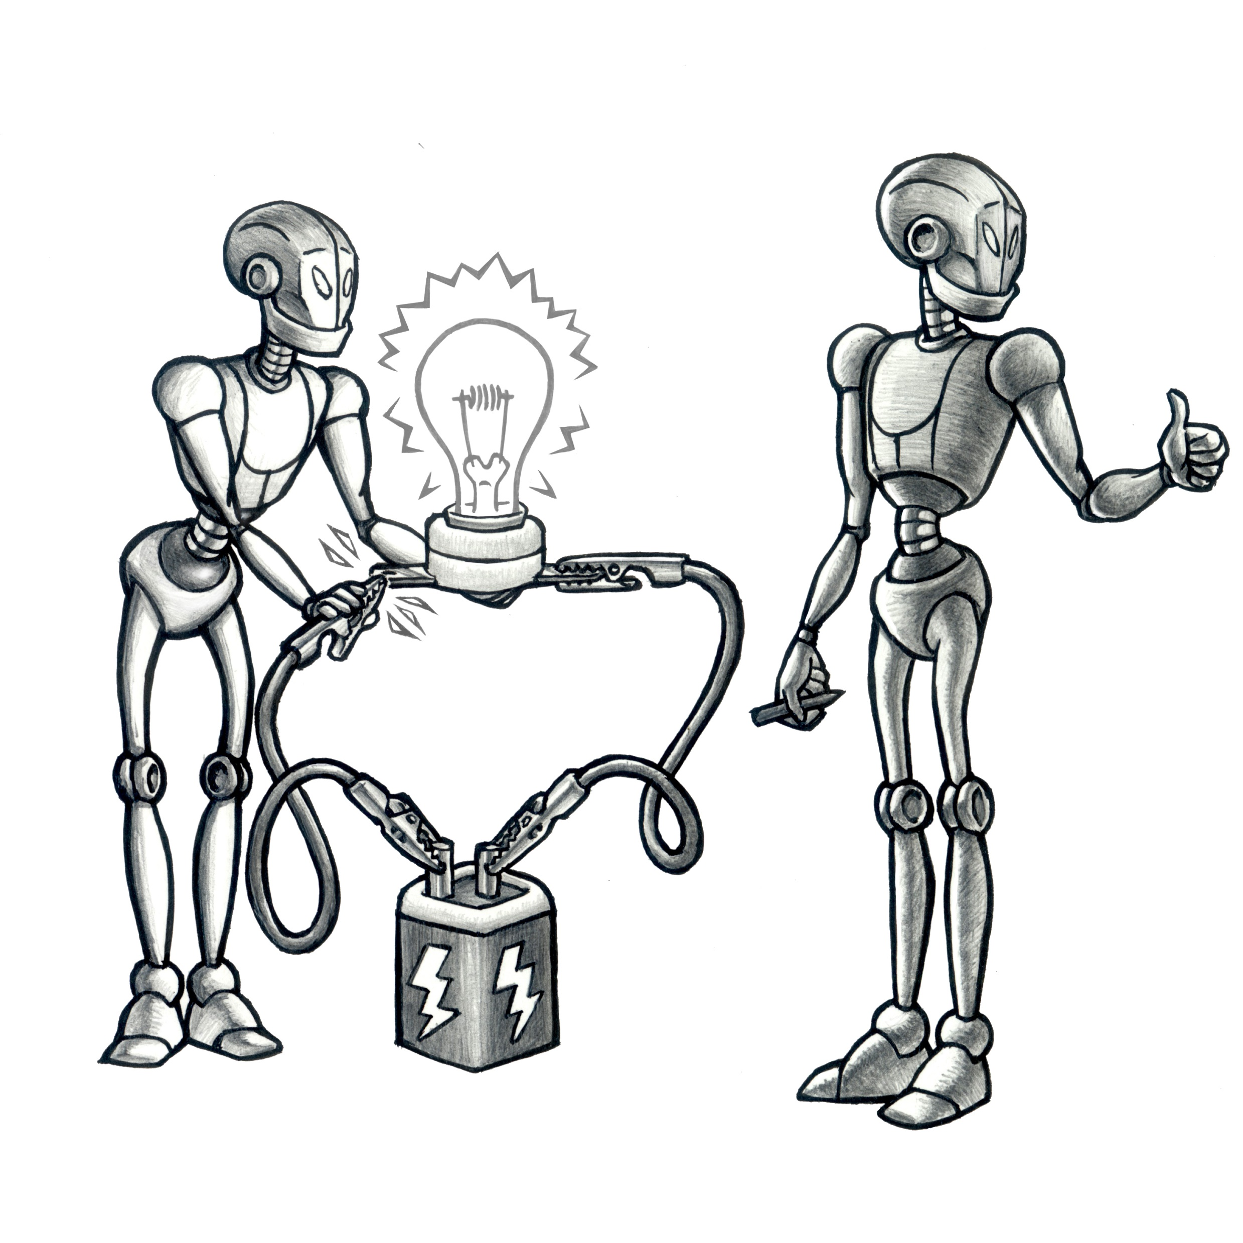
Notes:
End 6:30

Slide 6
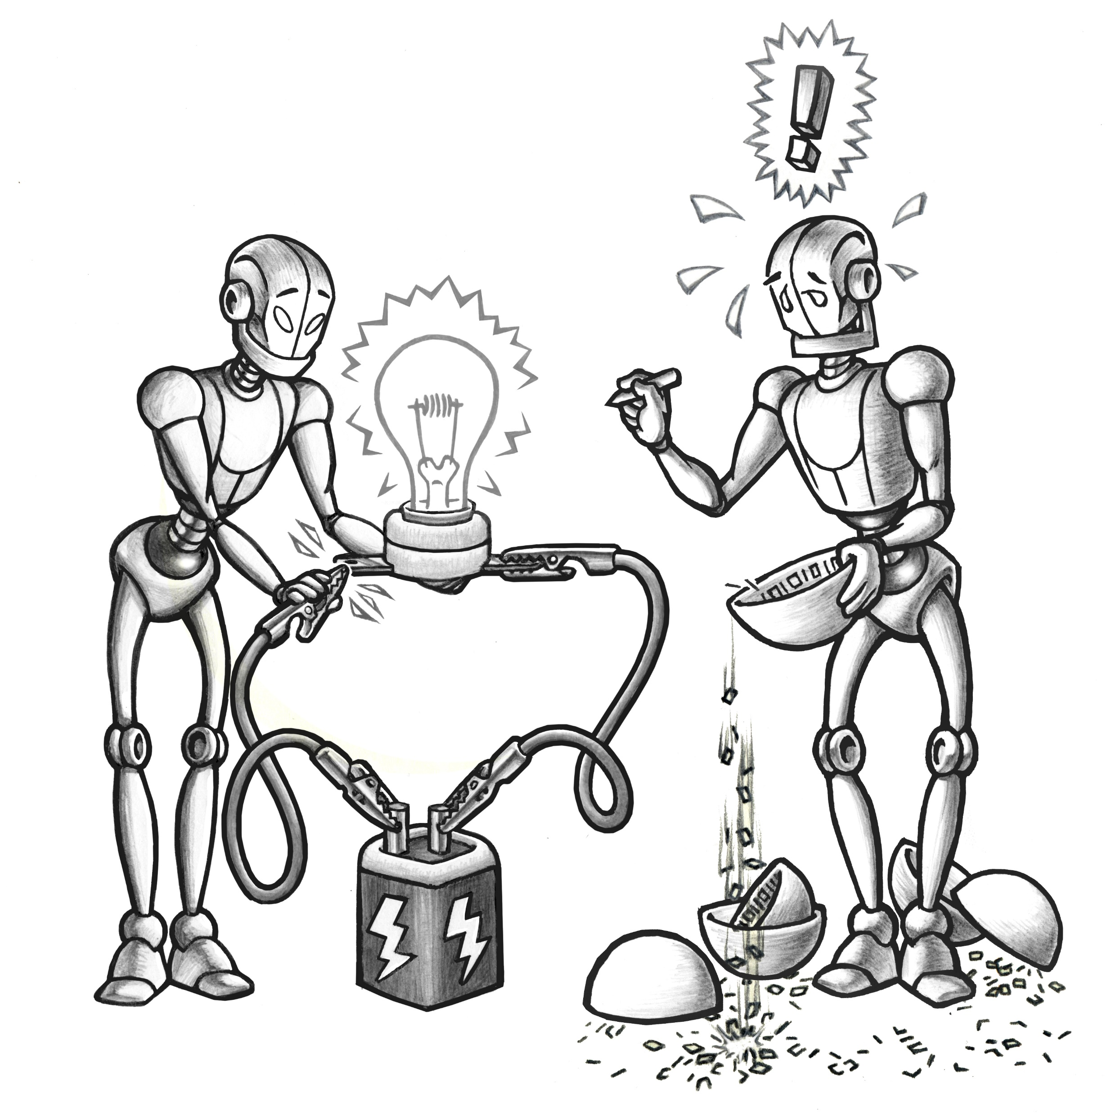
Notes:
End this slide 7:00

Slide 7
MetaAutomation saves all that information in a format that is:
Efficient
Readable
Naturally structured
Automation-friendly
Notes:
End this slide 8:00

Slide 8
MetaAutomation complements these practices:
CI/CD
A/B testing
Manual test
Notes:
End 8:30

Slide 9
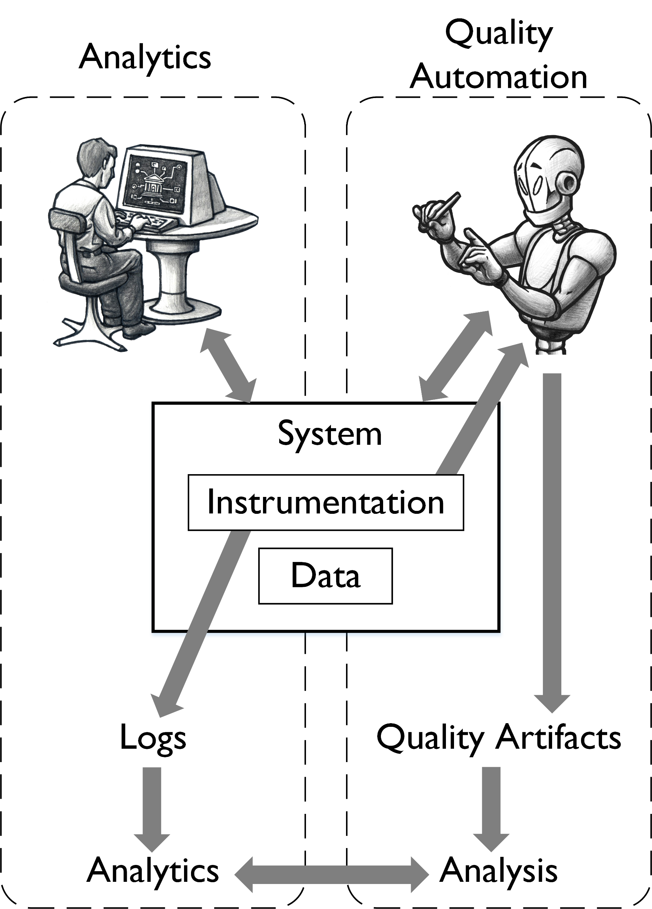
Product instrumentation serves the team before and after product ship
Notes:
End this slide 9:00

Slide 10
MetaAutomation obsoletes these practices:
Automating manual test cases
Running checks manually
Gherkin/keyword automation
“If it doesn’t find bugs, don’t bother.”
Notes:
End this slide 11:00

Slide 11
MetaAutomation means nobody has to go and ask QA:
“What’s going on with this check?”
“Do you feel good about your automation?”
“What does your automation miss?”
“Would you please take me off the SPAM lists?”
Notes:
End this slide 13:00

Slide 12
QA role can be the backbone of communication and collaboration, in a way not possible before!
Notes:
End this slide 15:30

Slide 13
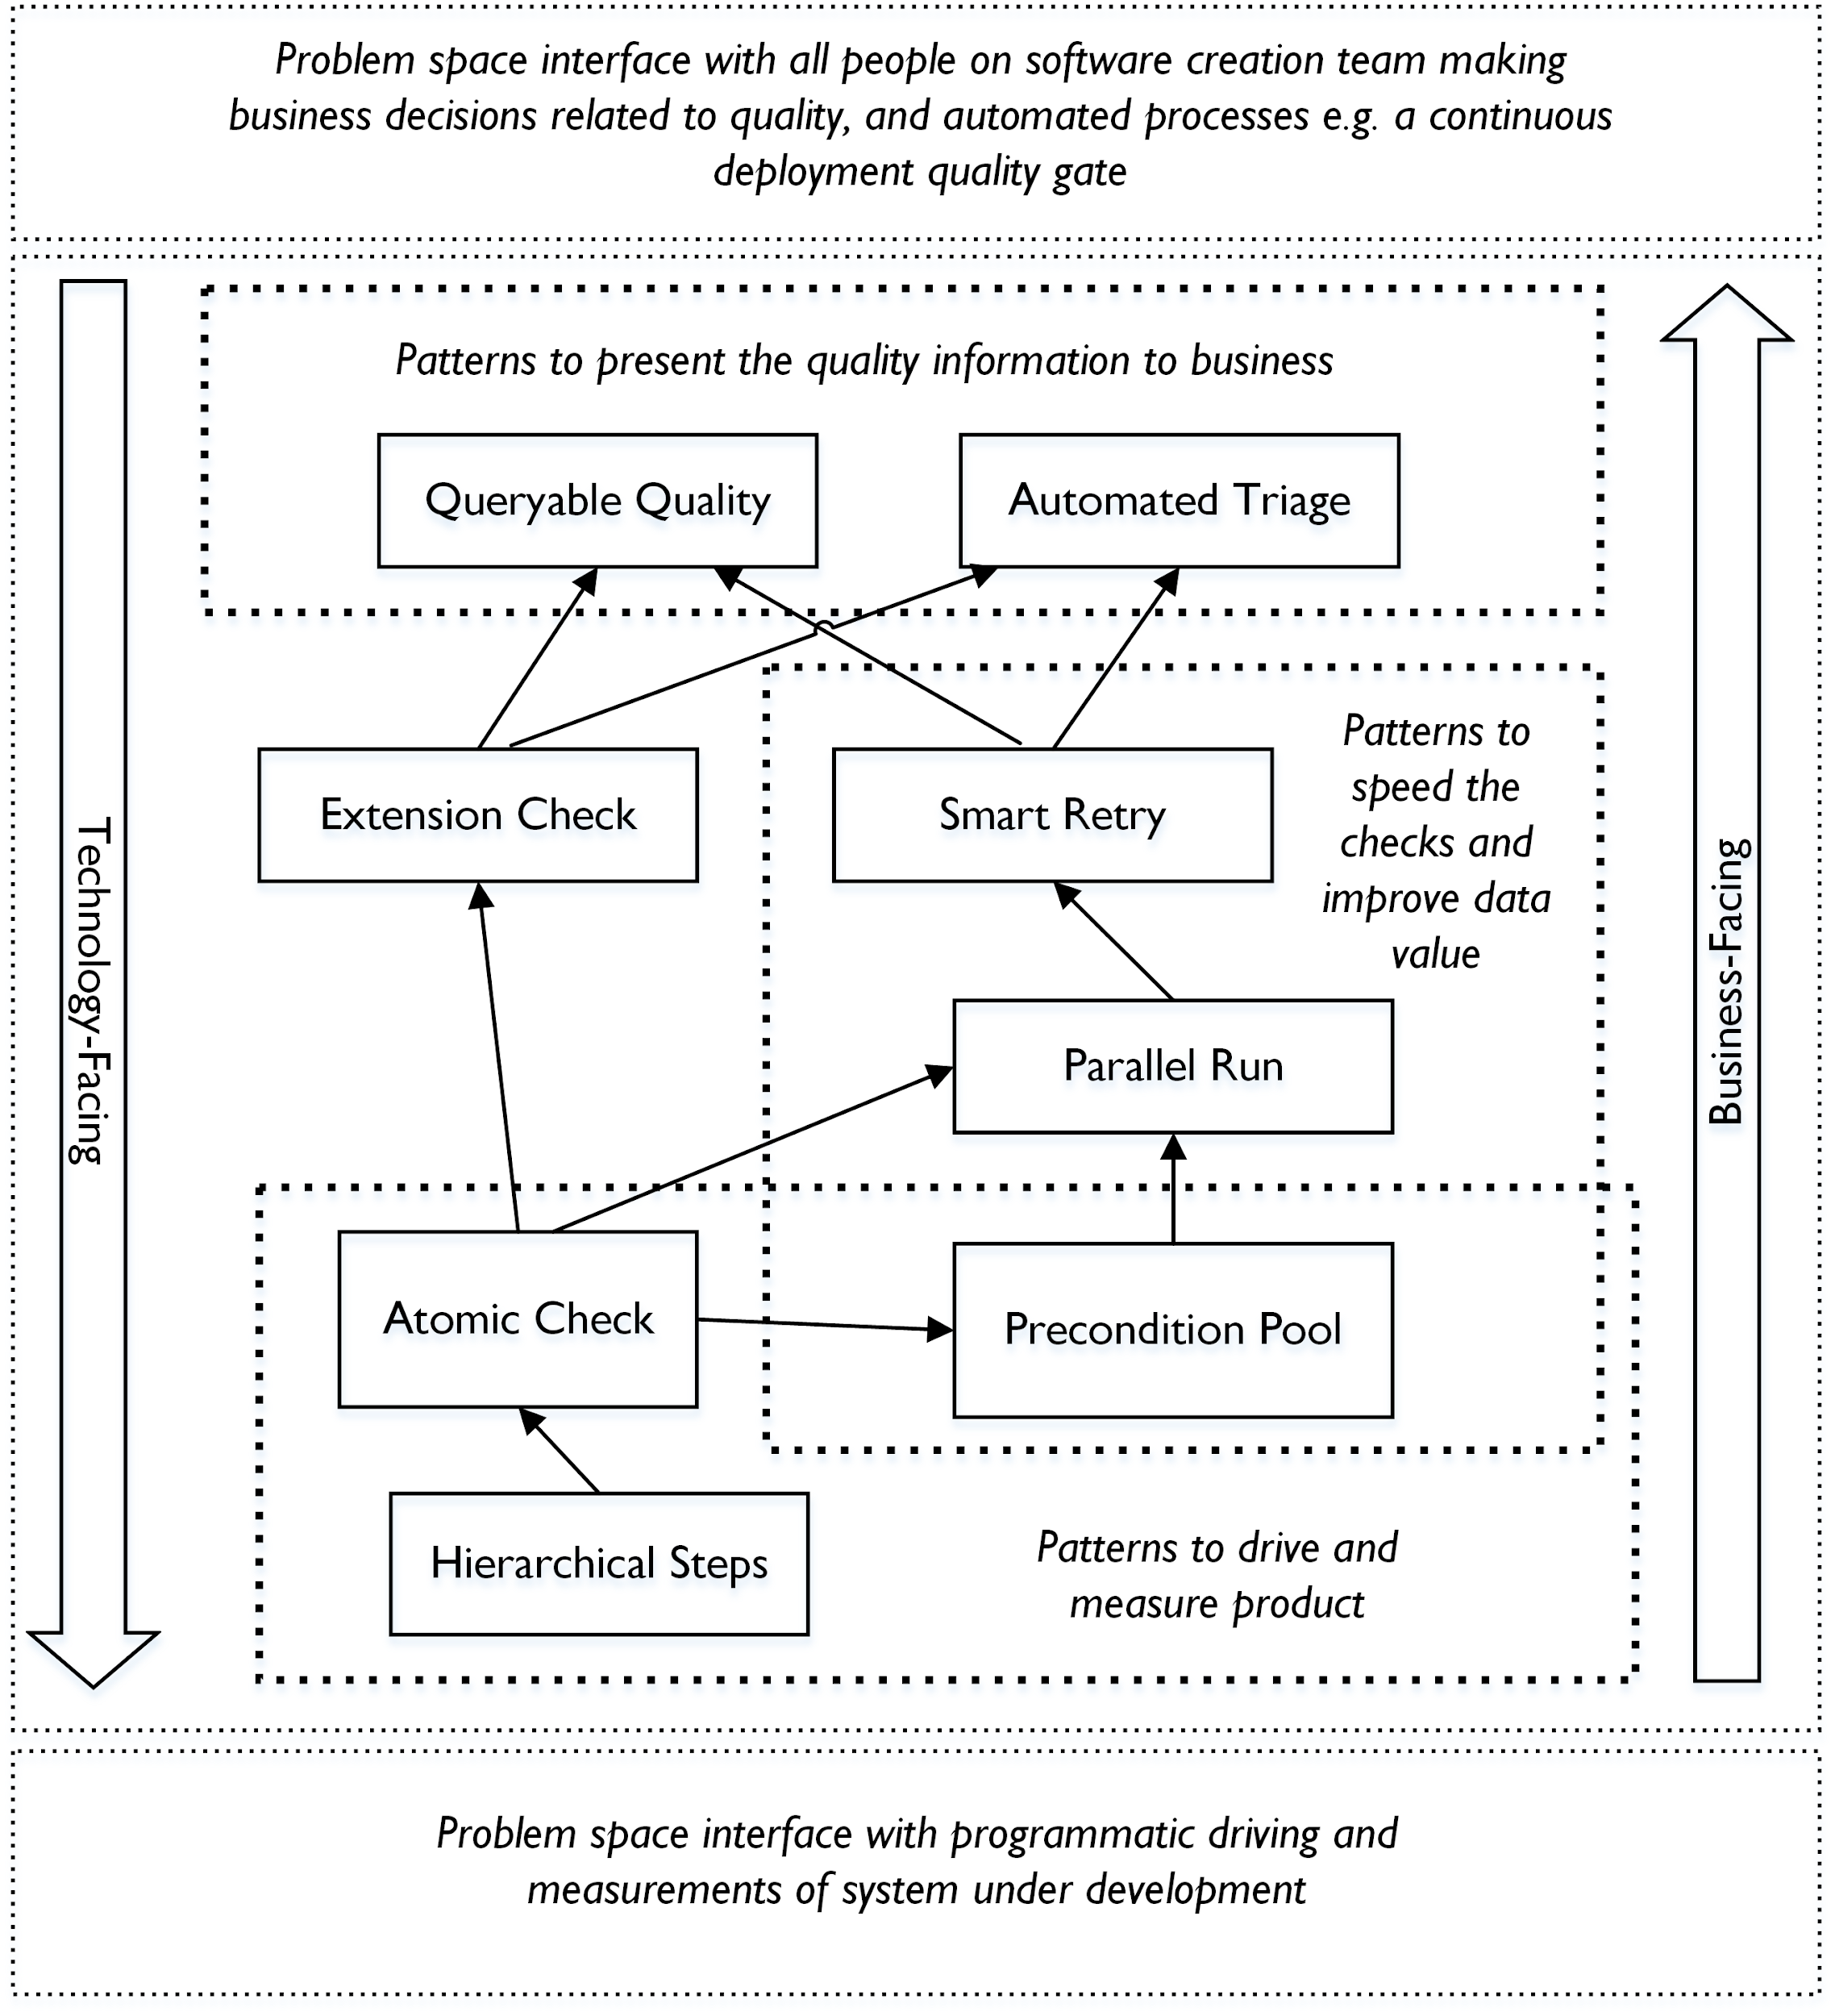
Quality Automation
Notes:
End this slide 16:00

Slide 14
Notes:
End this slide 19:30

Slide 15
Team on track
!
QA on it
Visible quality
Focused notifications
Notes:
End 20:00

Slide 16
Team on track
QA on it
Visible quality
Focused notifications
Notes:
End this slide 30:00

Slide 17
A tells B

Slide 18
B tells A

Slide 19
Can MetaAutomation help your situation?
Notes:
End Discussion 47:00

Slide 20
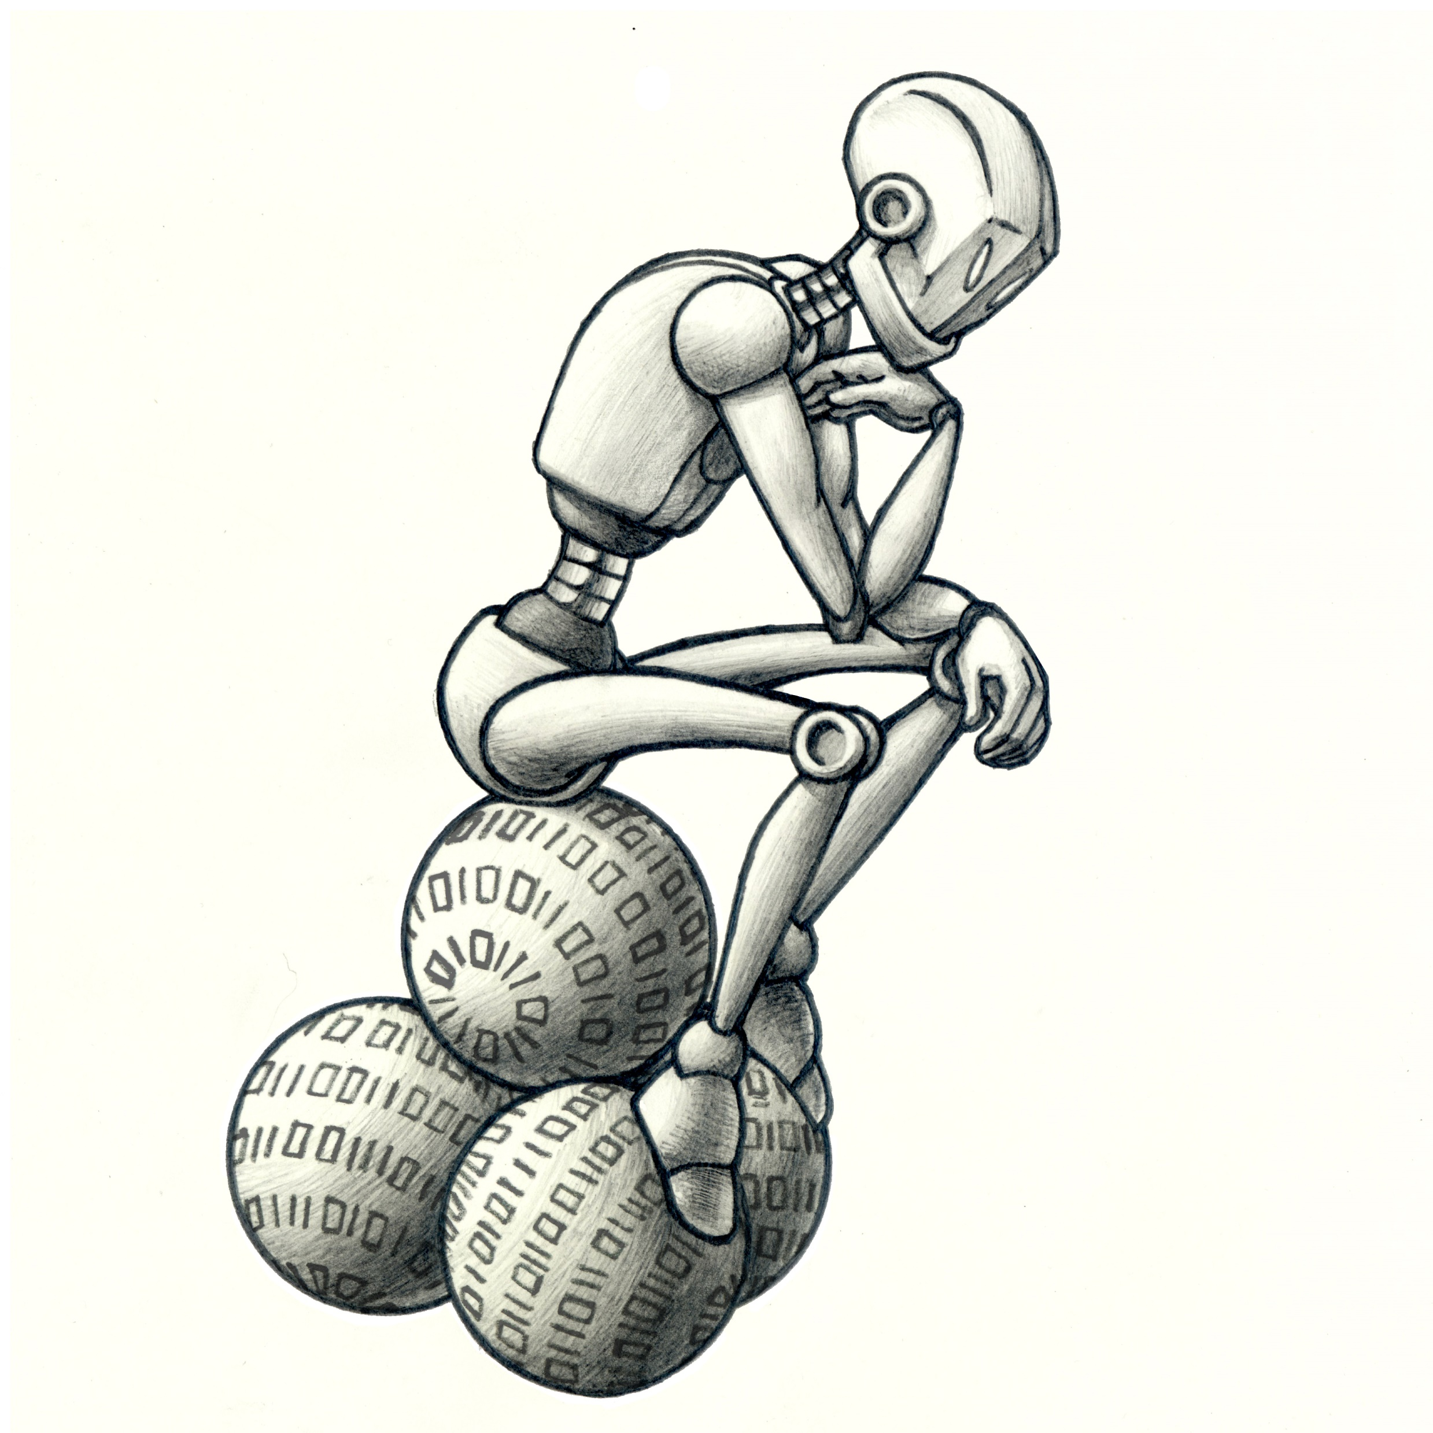
Notes:
end 47:30

Slide 21
Notes:
End at 48:00

Slide 22
Homework…
Consider the three paradigm shifts presented on MetaAutomation.net
Contribute to blog
Contribute to LinkedIn groups
Contribute to GitHub
Contribute to pattern language
Notes:
End at 49:00

Slide 23
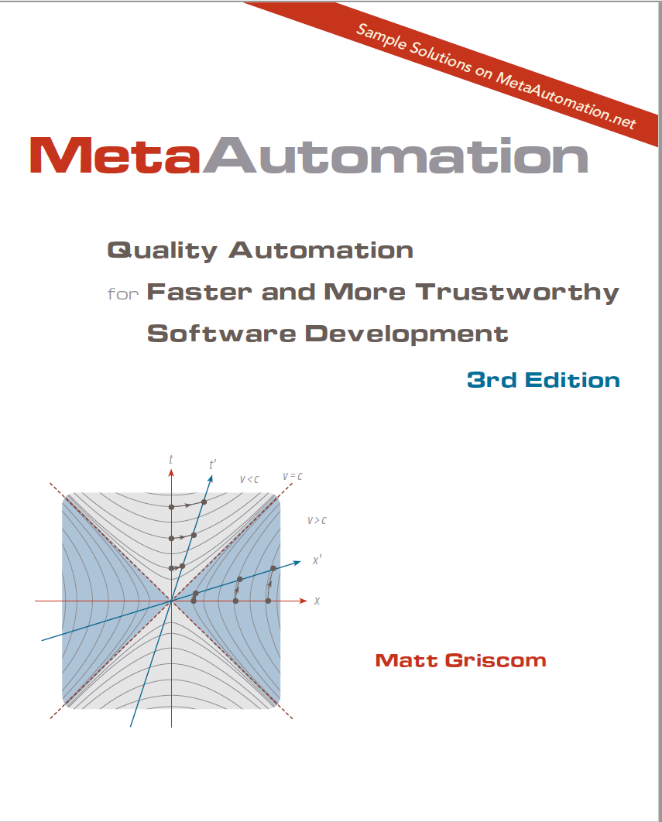
3 open-source samples and a VS extension on GitHub!
http://metaautomation.net
matt@metaautomation.net
Notes:
End at 50:00

